Slide 1

Advance Programming Concept
Expense Tracker
Karunya Gupta - 2310990625
Kartik Jindal – 2310990624
Mudit Kalra - 2310990660
Miyesha Jain - 2310990663
Class Group: G8

Slide 2
Introduction
The Enterprise Expense Tracker is a modern solution designed to streamline expense management operations for organizations of all sizes. Traditional methods such as paper-based reports, spreadsheets, or fragmented tools often lead to inefficiencies, errors, compliance risks, and a lack of real-time financial visibility. To overcome these challenges and meet the increasing demands of digital transformation and remote work, this project introduces a secure, scalable, and centralized expense management system

Slide 3
Problem Statement
Many organizations still rely on manual, paper-based expense processes or fragmented software solutions, leading to inefficiency and high error rates.
Manual data entry and expense approvals cause delays, inaccuracies, and administrative overhead, impacting financial accuracy and timely reimbursements.
Lack of real-time visibility into spending and budget utilization prevents informed financial decision-making and effective cost control.
Traditional systems are not scalable or flexible enough to handle remote work, digital transformation, and integration with modern platforms.

Slide 4
System Overview
RESTful API Controller - Handles HTTP requests for companymanagement operations at /api/companies endpoint
CRUD Operations - Provides complete Create, Read, Update, Delete functionality for company entities
Standard HTTP Methods - Maps POST (create), GET (read), PUT (update), DELETE (remove) operations with appropriate response codes
Path Variable Support - Uses /{id} for specific company operations and supports both single company and all companies retrieval
DTO Pattern Implementation - Uses CompanyDto for data transfer, delegating business logic to CompanyService layer for clean separation of concerns

Slide 5
Proposed Solution
The system follows a modular, scalable architecture based on the Model-View-Controller (MVC) pattern using Spring Boot 3.2.0 and Java 17 for building RESTful API services.
Security is implemented through Spring Security with JWT-based authentication and role-based access control, supporting flexible permissions for company owners and members.
Data persistence is managed using Oracle Database with JPA/Hibernate ORM, enabling complex entity relationships and ensuring data integrity through Flyway-managed versioned migrations.
The system supports multi-company management with many-to-many relationships between users and companies, facilitating cross-organizational roles and permissions.
RESTful APIs enable seamless integration with web portals, mobile applications, and third-party financial tools, while the design supports horizontal scalability and optimized database performance.

Slide 6
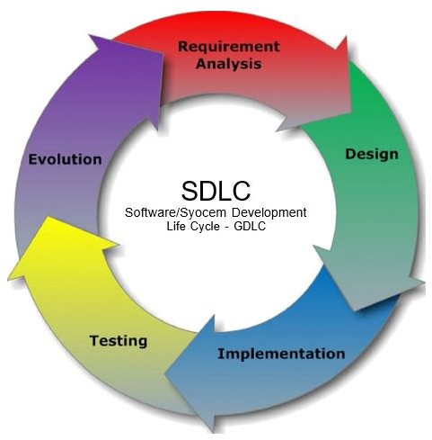
SDLC Models

Slide 7
Features & Benefits
The system offers centralized expense management with real-time tracking, automated approval workflows, and detailed financial reporting for enhanced visibility and control.
It supports multi-company and multi-role management, allowing users to operate across multiple organizations with role-based access control for secure and compliant operations.
Security features include JWT-based authentication, role-based authorization, encrypted password storage, and comprehensive audit trails to ensure data integrity and compliance.
The platform enables faster reimbursements by streamlining expense submission, approval, and tracking processes, improving employee satisfaction and reducing administrative overhead.

Slide 8
Tech Stack
Frontend: HTML5, CSS3, JavaScript
Backend: Java 17 with Spring Boot 3.2.0 framework for building RESTful APIs and implementing business logic.
Security: Spring Security with JWT (JSON Web Token) based authentication and role-based access control for secure user authentication and authorization.
Database: Oracle Database for enterprise-grade, reliable data persistence with JPA and Hibernate ORM for object-relational mapping and efficient database operations.

Slide 9
Conclusion
The Enterprise Expense Tracker project successfully delivers a secure, scalable, and centralized expense management solution tailored for modern business needs. It addresses critical challenges of outdated manual processes by automating expense submission, approval workflows, and real-time tracking, resulting in improved financial visibility and accountability. The system’s robust security features ensure compliance through JWT-based authentication and role-based access control, while its multi-company support enables flexible management of complex organizational structures. Overall, the project demonstrates a practical, enterprise-ready approach that significantly streamlines expense management, reduces errors, accelerates reimbursements, and empowers organizations to make data-driven financial decision.

Slide 10
References
Build a Smart Expense Tracker with Java, Spring Boot & OpenAI GPT: A Full Guide | by Lahiru Sandaruwan Premathilaka | Medium
Daily Expense Tracker System In Spring Boot and Hibernate With Source Code – Codebun
Spring Boot Project | Expense Tracker | Spring Boot Full Course | Project - 1

Slide 11
Thank you

